Slide 1

UNIVERSITY INSTITUTE OF COMPUTING
Agile Methodology
(24CAT-656)

Slide 2
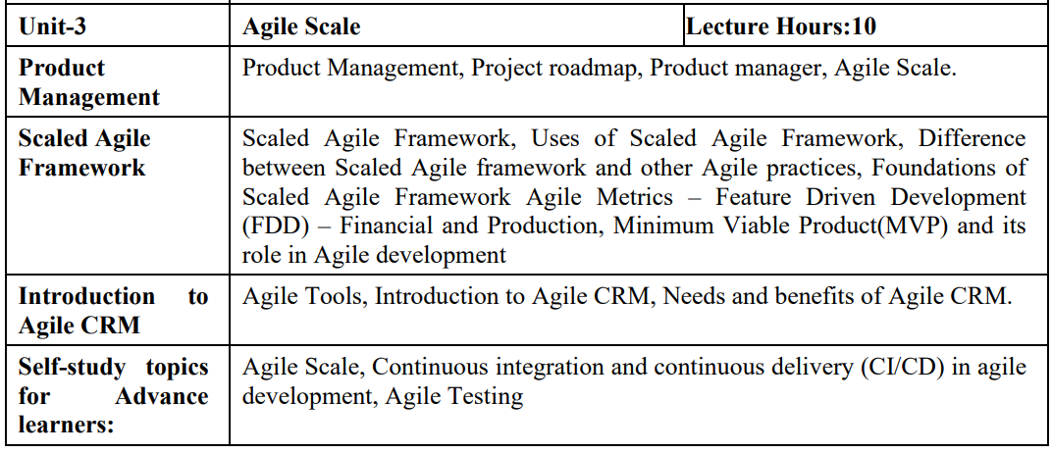
SYLLABUS
2

Slide 3
CONTENT OF THE SYLLABUS
TEXT BOOKS
T1 David J. Anderson and Eli Schragenheim, Agile Management for Software Engineering: Applying the Theory of Constraints for Business Results, Prentice Hall, 2003.
T2 Hazza and Dubinsky, Agile Software Engineering, Series: Undergraduate Topics in Computer Science, Springer, 2009.
T3 Agile Software Development Ecosystems by Jim Highsmith, Addison-Wesley 2002, ISBN 0201760436.
REFERENCES
R1 Craig Larman, Agile and Iterative Development: A Managers Guide, Addison-Wesley, 2004.
R2 Kevin C. Desouza, Agile Information Systems: Conceptualization, Construction, and Management, Butterworth-Heinemann, 2007.
3

Slide 4
What is agile product management?
The idea is to set product strategy and create product roadmaps in an agile environment. It encourages an adaptive approach to product planning and implementation so organizations can quickly respond to feedback and build products that customers love.
At its core, agile product management is a response to the widespread use of agile software development methodologies, such as scrum or kanban. These methods emphasize evolutionary development, early delivery, and continuous improvement.
4

Slide 5
Benefits of agile product management
Learn from customers throughout the product life cycle
Continuously adjust the near-term roadmap to meet customer needs
Deliver value to customers in an incremental way
Respond quickly to new and changing requirements
Collaborate with engineering to quickly deliver work
5

Slide 6
Agile product management practices
Set product strategy
Understand customer needs
Create the product roadmap
Prioritize features
Release customer experiences
Measure product success
6

Slide 7
Agile product management tools
Goal matrix
Planning board
User story maps
Burndown charts
7

Slide 8
What Is an Agile Roadmap?
Within an Agile group, the Product Owner is regularly chargeable for coping with no longer the simplest product backlog, however, defining the project’s imaginative and prescient and priorities. One of the approaches they outline the project’s imaginative, and prescient is with an Agile product roadmap.
8

Slide 9
Advantages of the Agile roadmap
Some of the advantages of the Agile roadmap consist of:
Providing a high-degree evaluation for stakeholders
Giving groups perception into priorities and timelines as context for daily responsibilities
Explaining the project’s importance — each for the business enterprise and the user/client
Articulating long-time period strategy
9

Slide 10
Time-primarily totally based roadmaps
As its call suggests, a time-primarily based total roadmap makes a specialty of how the project will evolve over a positive duration of time. This may be checked out in weeks, months, quarters, or maybe years. Stakeholders may also locate it particularly precious as it clarifies anticipated timelines and key releases without getting slowed down into daily processes.
10

Slide 11
Progress-primarily totally based roadmap
A development-primarily based total roadmap takes a “to-do” → “in development” → “complete” method to street mapping and is regularly represented via a Kanban-like board. It focuses extra on making development on important capabilities and releases, in place of meticulously following timelines or predetermined time frames.
11

Slide 12
How to create an Agile product roadmap?
To construct an Agile product roadmap that takes a long lens view of your project, first, articulate your imaginative and prescient. What fee might be brought to clients and what are the project’s major priorities, desires, and key goals? Establish project KPIs via a way of figuring out vital achievement signs and milestones.
12

Slide 13
How to create an Agile product roadmap?
If possible, tailor your Agile product roadmap to its supposed audience. The equal roadmap you gift to the project group will probably want to have extra elements than the only you give to different stakeholders who want to recognize the high-degree strategy, desires, and well-known time frames related to the project.
13

Slide 14
How to create an Agile product roadmap?
To get commenced with an Agile product roadmap of your own, strive for Restyaboard’s product roadmap template. It is an easy-to-use, vital part of your Agile toolkit. Create realistic, up-to-date, and powerful roadmaps that speak your product imaginative and prescient on your group and stakeholders.
14

Slide 15
THANK YOU

